Slide 1
API Enablement and Open Banking Operating Model Perspectives
March 2017
v0.17

Slide 2
We believe the current method & approach of the API-Enablement Operating Model puts at risk the successful delivery of the strategic capabilities required by Release 2. Hence we are proposing to prioritise the Operating Model design work following a joined-up approach across both projects.
Our Understanding of the Situation
API Enablement will define the foundational capabilities to allow Nationwide to build and operate APIs which expose business services internally and to third parties.
Open Banking will deliver the APIs and supporting business capabilities required to allow Nationwide to comply with the regulatory obligations arising from the CMA remedies and PSD2.
OB Release 2 will be the first project that will require a subset of capabilities delivered by API-Enablement. This covers the strategic capabilities required by Release 2 to run and support APIs post Go-Live in Jan18.
Thus, API-Enablement will not cover the capabilities required to deliver Release 2 – this responsibility resides within the Release 2 project.
The projects include delivery of any required operating model changes; in aggregate the two projects must deliver a joined-up operating model to support their combined scope
Identified Risks
As per the current OB programme structure API-Enablement and Release are working in isolation which raises the risk of misalignment.
Following the existing API-Enablement approach there is the risk that we will not be able to deliver the required capabilities in time for R2.
Proposed Solution
Prioritisation of API-Enablement Operating Model design for the capabilities required by Release 2
Introduction of joined-up approach for Operating Model design across both API-Enablement and Release 2

Slide 3
We have identified a number of risks to the timely delivery of the API-Enablement Operating Model design by “parking” it to later iterations following the current approach
API Enablement design approach to deliver the Strategic Operating Model
Identified Risks & dependencies
2017
2018
Risk #1 that one iteration of the OS Operating Model and HLOD will need to be written based on assumptions about the organisation’s strategy, future uptake and usage and market trends etc.
Risk #2 that a number of large strategic questions that remain open because the Operating Model aspects of the Conceptual Architecture has not been completed. These need to be answered to complete the OS iteration, which may lead to significant delays or progress at risk.
Risk #3 that there is no immediate plan to start work on the OS Operating Model iteration, which is likely to take a number of months to complete and get approval. Completion of HLOD Operating Model iteration and subsequent Business Readiness activities are dependent on the ARB approval of the OS.
Risk #4 of governance overhead. Each iteration of OS, and HLD and HLOD needs to be reviewed and then approved by senior management and by the respective approval boards.
Risk #5 that the Operating Model focus is currently limited to ‘keep the lights on’ IT support, which is a relatively simple and small part of the whole Operating Model.
Risk #6 that any requirements for IT changes e.g. new applications, changes to existing, new reports etc. needed by business areas in order for them to perform their role may not be identified in time to allow them to be developed.
Risk #7 that design strategic TOM does not meet expectations because no alignment with other OB projects and no business requirements in place for the OS i4 to response to.
Risk #8 that strategic capabilities for Jan18 deadline will not be implemented in time due to dependency of completion of TOM HLOD.
Mar
Apr
May
Jun
Q3 17
Q4 17
Jan
Conceptual Architecture
(Technology)
Risk that not in place in time for R2
2
Conceptual Architecture
Iteration 2
Operating Model design needs to be expedited for the capabilities required by Release 2
1
6
Architecture Overview
OS Iteration 1
(Public Production Infrastructure)
OS Iteration 2
(Corporate & CTC Environment)
OS Iteration 3
(Non Production & Dev Ops)
3
OS Iteration 4 (Target Operational Model)
OS iteration 5
(TOM follow-up)
HLD
HLD
4
HLD
HLID
(BT)
HLID
HLID
HLID
Tech Build
5
HLOD i1
(IT - Keep the lights on) )
HLOD i2
(IT - Keep the lights on) )
HLOD i3
(TOM)
R1 and 2 alignment required with API-E Operating Model
8
Business Readiness
Business Readiness
Release 1 Operating Model design
7
Release 2 Operating Model design
Exploitation projects (TBC)
Status:
completed
Planned for and in progress
Planned but not yet started
Not planned for

Slide 4
To overcome the identified delivery risks we are proposing an iterative and joined-up design approach for the Operating Model, prioritised by capabilities required to meet the regulatory Release 2 deadline
✓
Proposed Design Approach to jointly deliver the Strategic Operating Model required for Release 2 and beyond.
Indicative Timeline
Benefits, Risks & Dependencies
2017
Q1 2018
Benefits
Benefit #1 (addresses risks #1,2 of current approach) that update to CA to cover the operational aspects and answer the outstanding strategic questions can be used as a reference for the development of the OS, HLODs etc.
Benefit #2 (addresses risks #3,8 of current approach) of iterative design approach of OS and will allow to commence the business readiness of the highest priority areas.
Benefit #3 (addresses risk #4 of current approach) to reduce governance overhead by following iterative approach.
Benefit #4 (addresses risk #5 of current approach) to do the design beyond “keeping the lights on” and cover both IT and non-IT questions.
Benefit #5 (addresses risk #6 of current approach) to early identify any additional IT change requirements need by the business, e.g. changes e.g. new applications, changes to existing, new reports etc
Benefit #6 (addresses risk #7 of current approach) Alignment with operational design of Release 2 project. Architectural supervision required to avoid duplication of design effort.
Dependencies
Proposed method & approach needs to be agreed
Risk #1 of misalignment between IT and Operational streams across both API-E and other OB projects. Cross-workstream co-ordination required to mitigate risk.
Risk #2 of not meeting business requirements because no API strategy in place.
Jun
Dec
Current linear approach
Architecture Overview
OS Iteration 1
(Public Production Infrastructure)
OS Iteration 2
(Corporate & CTC Environment)
OS Iteration 3
(Non Production & Dev Ops)
OS Iteration 4 (Target Operational Model)
OS iteration 5
(TOM follow-up)
Proposed iterative approach
CA
Iteration 2
Co-ordination required with other API-E Tech streams
Operating model transition states
Transition State 1
Short Term*
HLOD
Iteration. 1
Tech Build & Business Readiness
Release 2 Go-Live
API Enablement
OS Iteration 4a (TOM)
OS Iteration 4b (TOM)
Transition State 2
Medium Term*
Short Term
HLOD
Iteration. 2
Business Readiness
Continuous Improvement
Long Term*
Medium Term
Continuous Improvement
Long Term
OS R2
Alignment with OB projects or other exploitation projects
R2
HLOD
R2
Tech Build & Business Readiness
Release 2 Go-Live
R1 Strat
4
Corporate

Slide 5
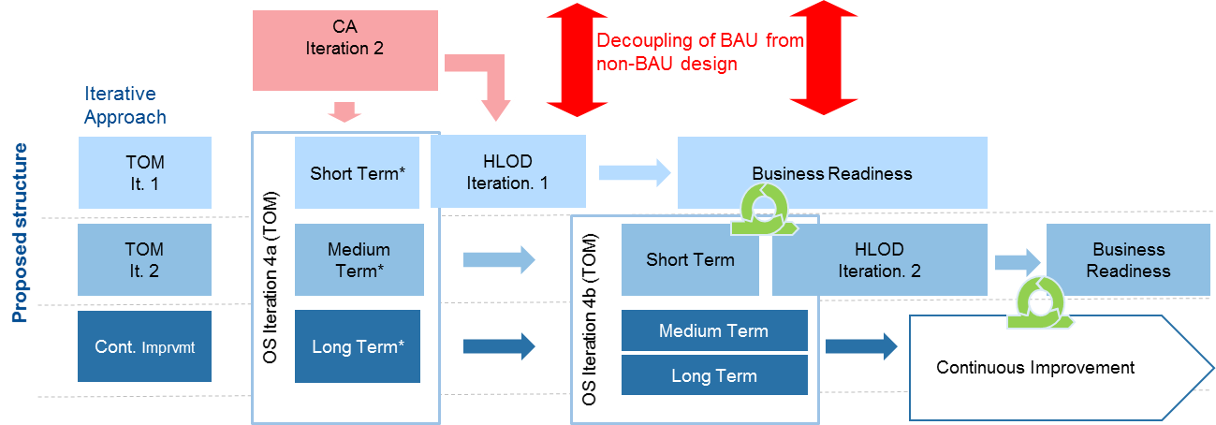
Capabilities delivered by API-E in line with R2 requirements
CA
OS Iteration 4a (TOM)
HLOD
Contents
Horizon
Outcome
Technology Required
Operating Model Required
Required by
B. Read.
Short Term*
R2 Go-live
Production R2 APIs
Dev, Test Environments, DevOps tooling
Production infrastructure
Impacts on capabilities, people, processes for supporting & maintaining APIs in production
IT support model for Infrastructure / Application support of Prod, Dev, Test, Environments, DevOps tooling
Jan18
tba
Medium Term*
tba
tba
tba
See Richard’s Excel capability traceability
Long Term*
tba
tba
tba
tba
Short Term
tba
N/A
Impacts on capabilities, people, processes for supporting & maintaining APIs in production
IT support model for Infrastructure / Application support of Prod, Dev, Test, Environments, DevOps tooling
tba
Short Term
tba
N/A
tba
tba

Slide 6
Following this iterative approach will allow API Enablement to deliver the target operating model via a roadmap of transition states just in time for regulatory and other exploitation projects
1. Strategic Operating Model generic capabilities delivered by API Enablement
2. The strategic capabilities will be delivered just on time required for consumption following an iterative approach
Iterative Operating Model Design in line with Roadmap transitions states
API TOM
It. 1
API TOM
It. 2
Continuous Improvement
Will strategic capabilities also required by regulatory project Release 2 and consumption of APIs internal corporate projects.
Will deliver the strategic capabilities required beyond regulation and internal consumption.
Will ensure ongoing improvements to the operating model.
*Increased level of API capability maturity by transition state
 | Release 1 CMA1a (Strategic) | Release 2 CMA2 / PSD2 | Corporate | Full API Enablement | Other Exploitation Projects
Strategy | ◔ | ◔ | ◐ | ◕
Change | ◔ | ◔ | ◐ | ◕
Run | ◐ | ◕ | ● | ◕
Governance | ◔ | ◐ | ◕ | ◕
Security | ◐ | ◕ | ● | ◕
3rd Party Management | ◔ | ◕ | ◕ | ◕
Monetisation | ○ | ○ | ○ | ◕
API Enablement Strategic Capabilities
Currently not in scope of API Enablement
Currently no requirements
Currently not defined
6
*See appendix II for detailed overview of transition states

Slide 7
High Level Plan, Resource Overview and Dependencies
High Level Operating Model Plan
Timeline
Indicative Timeline
2017
Q1 2018
Dependencies
Planning
Jun
Dec
Scope:
Agreed method&approach, scope boundaries in line with other OB projects (e.g. Release 2)
Understanding of IT content/solution and delivery plan
Agreed business requirements (HLR required for OS; DBR required for HLOD)
Clarification of external regulatory requirements and industry OpModel design
Team Structure:
Availability of resources: SMEs for design workshops
EBA, BSA, TSA and BA resources to complete business analysis and design activities
Governance:
NCF Governance: CA and OS need to be approved prior to HLOD
Review and approval lead time (2 week review cycles)
Identified OM design owner who is empowered to make design decisions, s/o and escalate risks/issues
Scope s/o
Method & approach, Detailed Plan;
Analysis&Design workshops set up
Analysis
HL Requirements s/o
CA Uplift
CA It. 2
TOM It. 1
OS It. 2
Business Readiness
HLOD It. 1
TOM It. 2
OS It. 3
Business Readiness
Team Structure
HLOD It. 2
Continuous Improvement
Resource | Allocation | Deliverable | Activities
DL | 100& | N/A | Project and stakeholder management, escalations, facilitation
EBA | 100% (till CA complete) 50% (thereafter) | CA uplift with TOMs | Overall ownership of delivery of TOM
BSA x 2 | 100% | TOMs / HLODs | Support EBA in delivery of TOM iterations Delivery of HLOD Solution Assurance of Business Readiness
SSA | 25% | N/A | E2E Solution Assurance / Alignment
ITSA | TBC% | OS | Tooling solutions / consultancy
BA x 2 | 15% (for planning) 100% (from analysis) | Process Design | Workshop facilitation BSA / EBA Support AS IS and To Be process work
IT/Business SMES | 25% | SME input | Attending of design workshops
Legend:
Deliverable

Slide 8
Next steps
Detailed planning based on agreed method and approach (in line with other OB projects)
Detailed scoping
API Enablement boundaries
Alignment with other OB projects to avoid duplication of effort
Stakeholder engagement & set up of workshops
Resourcing & onboarding

Slide 9
Appendix I – Deliverables Overview

Slide 10
Each deliverable is a stepping stone towards delivery of the API Target Operating Model
Deliverable | Horizon | Horizon Length | Description | Input
CA (iterations) | Short Term | Capabilities Required within next 12 months. | Extension of Conceptual Architecture to include consideration of API operating model elements required within next 12 months | Internal: HL Requirements External: IE industry Operating Model
 | Medium Term | Capabilities Required within next 12-24 months. | Extension of Conceptual Architecture to include consideration of API operating model elements required in next 12-24 months.
 | Long Term | Capabilities required 24+ months | Extension of Conceptual Architecture to include consideration of API operating model elements required for strategic longer term.
OS (iterations) | Short Term | Capabilities Required within next 12 months. | Detailed understanding of the capability required and the current maturity of the organisation including the people, process and customer impacts defined in enough detail to allow HLODs to progress | Internal: AO HL Requirements CA External: IE industry Operating Model
 | Medium Term | Capabilities Required within next 12-24 months. | High Level understanding of the capability required and the current maturity of the organisation and understanding of the people, process and customer impacts
 | Long Term | Capabilities required 24+ months | Conceptual idea of the capability required
HLOD (iterations) | Short Term | Capabilities Required within next 12 months. | Detailed design of changes required to processes, people, systems and organisational structures. | Internal: HLRs / DBRs CA OS External: IE industry Operating Model

Slide 11
Appendix II – Operating Model Roadmap Transition States

Slide 12
Transition State I - Release II
 | Release 2 CMA2 / PSD2 | Description
Strategy | ◔ | Non-discretionary externally mandated (regulatory) APIs only “Strategic” decisions for specific APIs made at project level
Change | ◐ | Tactical processes for “reference data”, “private data” and “transactional” APIs managed by project
Run | ◕ | Operation and support of API Gateway for “reference data”, “private data” and “transactional” APIs integrated into NBS BAU processes and tooling Limited integration with wider channel management processes
Cross Cutting Concerns:
Governance | ◐ | Strategy: Project level governance for externally mandated (regulatory) APIs only Change / Run: Tactical processes for “reference data”, “private data” and “transactional” APIs managed by project Manual integration to NBS processes
Security | ◕ | Support for APIs exposing public data hosted in cloud or in house Support for APIs exposing sensitive member data and transactional APIs hosted in house Integration with NBS BAU processes and tooling
3rd Party Management | ◕ | Processes in place for CMA and PSD2 3rd parties
Monetisation | ○ | None

Slide 13
Operating Model Capabilities
 | PLAN | BUILD | RUN
Strategy | ✓
Change |  | ✓
Run |  |  | ✓
Cross Cutting Concerns:
Governance | ✓ | ✓ | ✓
Security | ✓ | ✓ | ✓
3rd Party Management | ✓ | ✓ | ✓
Monetisation | ✓ | ✓ | ✓

Slide 14
Transition State II - Corporate
 | Corporate | Description
Strategy | ◐ | External APIs: Non-discretionary externally mandated (regulatory) APIs only - “strategic” decisions for specific APIs made at project level Internal APIs: API roadmap defined to guide development of internal APIs
Change | ◐ | Tactical processes for “reference data”, “private data” and “transactional” APIs managed by project Internal and external API development capability
Run | ● | Operation and support of API Gateway for “reference data”, “private data” and “transactional” APIs integrated into NBS BAU processes and tooling Support for internal and external APIs Full integration with wider BAU channel management processes
Cross Cutting Concerns:
Governance | ◕ | Strategy: Project level governance for externally mandated (regulatory) APIs; governance for internal APIs embedded into existing processes Change / Run: Tactical processes for external APIs managed by project; governance for internal APIs embedded into existing processes
Security | ● | Support for APIs exposing public data hosted in cloud or in house Support for APIs exposing sensitive member data and transactional APIs hosted in house Support for internal and external APIs Full integration with NBS BAU processes and tooling
3rd Party Management | ◕ | Processes in place for CMA and PSD2 3rd parties
Monetisation | ○ | None

Slide 15
Transition State III - Full API Enablement
 | Full API Enablement | Description
Strategy | ◕ | Business strategy development capabilities include consideration of opportunities and threats arising from APIs and API-enabled propositions Strategic API roadmap defined to guide development of internal APIs
Change | ◕ | Internal and external API development capability embedded into NBS BAU processes
Run | ◕ | Operation and support of API Gateway for “reference data”, “private data” and “transactional” APIs integrated into NBS BAU processes and tooling Support for internal and external APIs Full integration with wider BAU channel management processes
Cross Cutting Concerns: | ◕
Governance | ◕ | Strategy, change and run governance for external and internal APIs embedded into NBS BAU processes
Security | ◕ | Support for APIs exposing public data hosted in cloud or in house Support for APIs exposing sensitive member data and transactional APIs hosted in house Support for internal and external APIs Full integration with NBS BAU processes and tooling
3rd Party Management | ◕ | Processes in place for all API-related 3rd parties
Monetisation | ◕ | Support for monetisation of APIs

Slide 16
Project Objectives
API Enablement will define the foundational capabilities to allow Nationwide to build and operate APIs which expose business services internally and to third parties
Defines generic capability independent of any exploitation projects - scope extends to usage beyond Open Banking Compliance
Covers APIs which are consumed internally by Nationwide applications or externally by third parties
Covers the business and IT operating model changes to support “API as a channel”.
Open Banking will deliver the APIs and supporting business capabilities required to allow Nationwide to comply with the regulatory obligations arising from the CMA remedies and PSD2
Delivers the specific APIs which are required for CMA and PSD2 compliance - scope extends beyond API Gateway
Covers all development activities to deliver the required APIs and support their usage by third parties
Covers operating model changes to meet the industry model defined by the CMA Implementation Entity
Release 1 - CMA1 tactical
Open Banking
TBC - CMA1 strategic
Release 2 - CMA2 / PSD2
Other API Exploitation
(Out of Scope for Open Banking Programme)
API Enablement
Support for Open Banking Requirements
Support for Other API Exploitation
In aggregate these projects must deliver the operating model changes to support the “open banking” services required to comply with the CMA remedies and PSD2 and the generic enabling capabilities required to support exposing additional services via APIs.

Slide 17
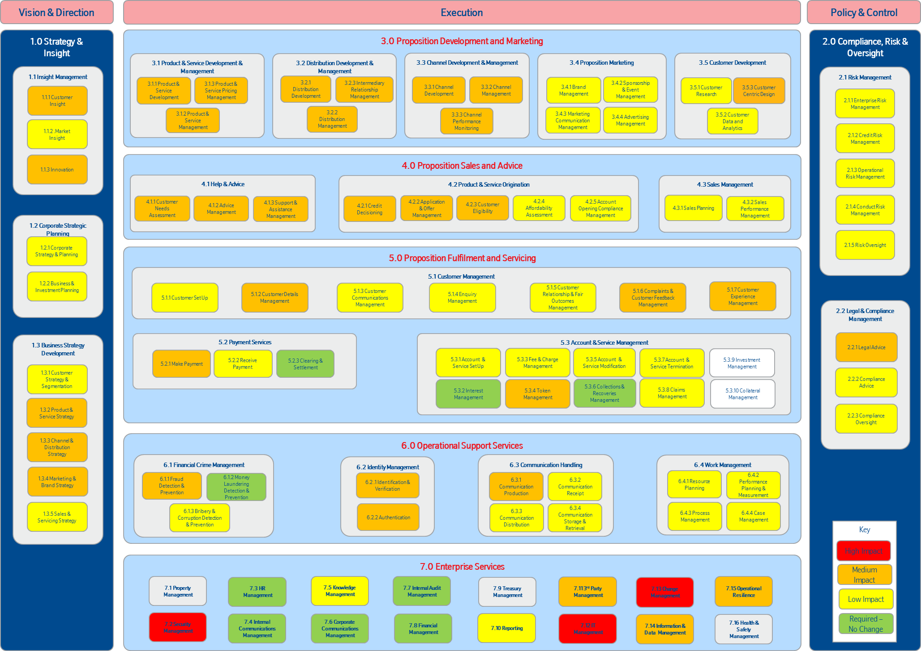
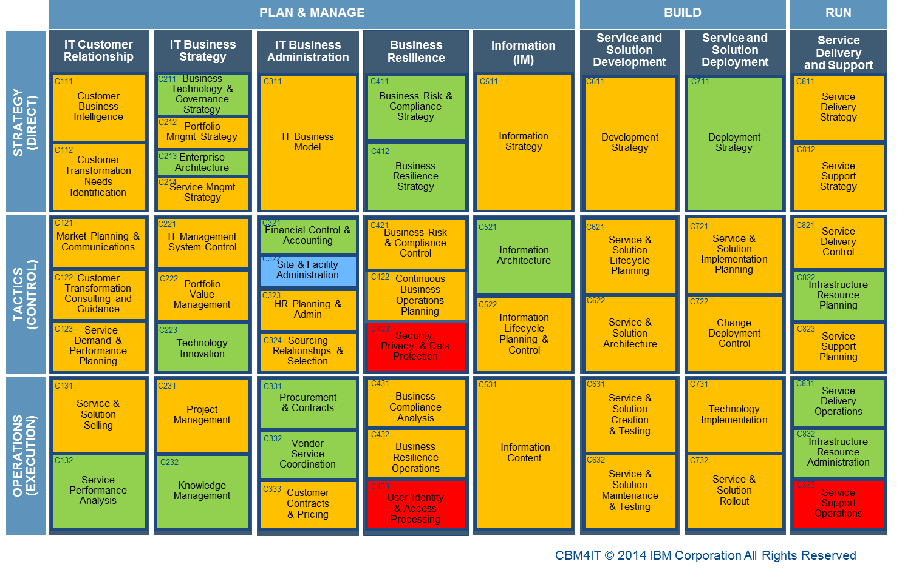
We need to clarify assumptions and questions regarding the coverage of the API Enablement Operating Model
How much of the enterprise is considered?
It is assumed that API Enablement will cover both the IT and non-IT related capabilities required to enable the Society to expose services via APIs.
To what extent are the operational requirements of exploitation projects covered?
It is assumed that API Enablement will just cover the common capabilities required by all or most business services which we expose via APIs.
What timeframe is covered?
It is assumed that API Enablement will deliver the target state via a roadmap of transition states which include the required operating model elements for the capability increments delivered.
Will there be a requirement for a transition state which delivers the strategic version of the Release 1 solution?
How far beyond the requirements of Open Banking does the operating model go?
It is assumed that API Enablement will cover API Gateway use cases beyond the CMA remedies and PSD2.
What is the timeframe for wider usage, e.g. corporate APIs?
Is API Enablement the vehicle for implementation of DevOps into Nationwide?
It is assumed that enterprise-wide DevOps will be a separate project and API Enablement will consider the API Gateway only.
How feasible is it to adopt DevOps unilaterally for APIs?
Nationwide Business Capability Model
The current approach only covers IT Management which is just one of many Business Capabilities which will be impacted by the introduction of APIs.
Nationwide IT Capability Model

Slide 18
The Operating Model impacts of the CMA Remedies and PSD2 are spread over multiple projects
Project
Operating Model impact
“Open Banking”
API Enablement
Includes:
Operating Model changes required to support future delivery and governance of APIs, and support for third parties developing against those APIs
Operating Model changes required to support BAU introduction of new IT infrastructure
API Enablement HLOD
Open Banking Compliance – Release 2
Includes:
Non-API related Operating Model changes required to support compliance with the “Open Banking” elements of the CMA Remedies and PSD2
Any additional changes to the API Platform Operating Model required to support the specific APIs required for the CMA Remedies and PSD2
Open Banking HLOD
How do we ensure that we have a joined-up operating model?
Others (Out of Scope)
Other CMA Remedies
Includes:
Any Operating Model changes required to support compliance with the non “Open Banking” elements of the CMA Remedies
HLOD
Other PSD2 Remedies
Includes:
Any Operating Model changes required to support compliance with the non “Open Banking” elements of the PSD2
HLOD
GDPR
Includes:
Any Operating Model changes required to support compliance with the GDPR (may result in Change Requests being raised for Open Banking projects)
HLOD

Slide 19
In the API Enablement Method and Approach the Operating Model impacts are spread over multiple workstreams
Workstream
Operating Model impact
Status
(validated against API Enablement M&A)
API Enablement
Conceptual Architecture
Should include Operating Model viewpoints
No operating model content currently included
TBC if CA iteration required
API Enablement HLOD (in iterations)
Reference Architecture
Includes Operating Model viewpoints
Some references to operating model tooling
Reference Implementation
May include operational aspects?
N/A?
Public Production Infrastructure
Includes the changes necessary to support the solution (including any new technologies) in line with current BAU processes
OS i2 includes basic “keep the lights on” IT requirements; HLOD i1 planned
Corporate Production Infrastructure
Includes the changes necessary to support the solution (including any new technologies) in line with current BAU processes
OS i2 includes basic “keep the lights on” IT requirements; HLOD i1 planned
Operating Model
Designs and implements the overall operating model changes to support future delivery and governance of APIs, and support for third parties developing against those APIs
Planning in progress for CA It., OS i4 and HLOD i4
Non Prod Environments
Includes the changes necessary to support the solution (including any new technologies) in line with current BAU processes
OS i3 to include basic “keep the lights on” IT requirements; HLOD iTBC
OLS and B2B Environments design
Includes the changes necessary to support the solution (including any new technologies) in line with current BAU processes
OS i3 to include basic “keep the lights on” IT requirements; HLOD iTBC
Build support - Public
May include support for operating model aspects of first adopter project?
TBC if OS / HLOD iterations required
Build Support - Corporate
May include support for operating model aspects of first adopter project?
TBC if OS / HLOD iterations required
Security Architecture
Includes Operating Model viewpoints, e.g. Security MI (SEIM)
TBC where design work for this workstream will be covered
Project Management & Integration
Coordinates activities to ensure joined-up operating model?
Ongoing
CMA Release 1 (FKA Cloud Mitigation)
Tactical solution with separate HLOD which includes all operating model aspects (out of scope for API Enablement operating model)
It is assumed that a single HLOD (with multiple iterations) will be produced covering all workstreams
Status:
completed
In progress
Not started / TBC
Not currently planned for

Slide 20
Appendix III – EPM Risk Log

Slide 21
EPM Risk Log I
Risk ID | Title | Risk | Cause | Impacts | Impact to Delivery | Likelihood | Risk Score | RAG | Risk Cost | Mitigation | Contingency | Progress Updates | Impact Date | Review By Date | Owner | Assigned To
91 | Capability - Strategic TOM design diverts from OpModel design of Release 1 and 2 | There is a risk that the strategic TOM design does not align with the operating models put in place under Release 1 and 2. | This is because the strategic TOM stream as it is currently set up is not in sync with Release 1 and 2, lagging behind and does not have the sources / structure / stakeholder engagement and priority to progress. | This could result in a "through away" TOM design because previous Releases will already have established an Operating Model for the society. | 3 - Major | 3 - Likely | 11 | Amber | Up to £100,000 | Align strategic TOM stream with release streams |  |  |  | 16/02/2017 | Craig Storey | Markus Kovar
39 | Capability - New operational capability required early | There is a risk that the operational capability (e.g. design, development, support) is required early. | This is because of Open Banking and future branch want to start work as soon as possible. | This could result in Open banking / future branch compromising their deliveries or the project making tactical choices and compromising the strategic goal. | 2 - Moderate | 4 - Highly Likely | 8 | Green | £50,000 | Establish how the other project requirements can be fulfilled without compromising the strategic approach. |  | 9/2 CS / MK creating plan and to discuss resourcing with Janet | 24/03/2017 | 23/02/2017 | Sarah Applegarth | Markus Kovar
19 | Capability - Lead time for resourcing & headcount freeze in CIO | There is a risk that the project will struggle to implement the right operating model due to a head count freeze in CIO. | This is because the headcount freeze will not allow any new roles and will take up capacity within existing roles. | This could result in protracted design period and compromises in the design. | 2 - Moderate | 3 - Likely | 7 | Green | £100,000 | Establish impact and review alternatives |  | 25/08/2016 AB: Owner changed from Debra Bailey to Grant Valentine and assigned to Markus Kovar. | 01/03/2017 | 16/02/2017 | Lynn Banagan | Markus Kovar
22 | Capability - Changes to the CIO op model | There is a risk that it the API Operating model is harder to design and land. | This is because the CIO operating model is under review | This could result in the operating model and design being protracted and add confusion to people being impacted. | 2 - Moderate | 3 - Likely | 7 | Green | £50,000 | Representatives from CIO to assist. |  | 25/08/2016 AB: First draft expect end of November 2016. | 24/02/2017 | 16/02/2017 | Grant Valentine | Markus Kovar
59 | Capability - Business Ownership | There is a risk that the TOM for API Enablement does not meet the business needs | This is because no business owners have been involved yet. | This could result in considerable re-work for the TOM | 2 - Moderate | 3 - Likely | 7 | Green | Up to £100,000 | Identify business stakeholder owners and engage in design work of API Enablement TOM | Re-design of TOM | 17/11/2016 MK: MK engaged with Sarah Applegarth to understand Business Change workstream and flagged that the project has not yet had business stakeholder engagement | 31/08/2017 | 16/02/2017 | Sarah Applegarth | Markus Kovar

Slide 22
EPM Risk Log II
40 | Release 2 - FinTech develop unsecure App's | There is a risk that Fintech's develop unsecure App's | This is because we don't have complete control over their development | This could result in customer data being breach and or financial impact | 2 - Moderate | 3 - Likely | 7 | Green |  | Risk to be addressed in the operating model as part of 3rd party developer onboarding |  | 06/10/2016 API changed to APP's (spell check issue) | 14/07/2017 | 24/02/2017 | Richard Christopher | Markus Kovar
25 | Capability - Centre of Excellence Ownership | There is a risk that the Centre of Excellence (CoE) Operating Model is defined without the involvement of the final owner of the CoE. Considerable re-work may be required in case final owner does not agree with design. This also causes a lost opportunity. | This is because early engagement was not possible due to non-identified ownership. | This could result in considerable re-work if the named owner of the CoE does not agree with the design. | 2 - Moderate | 3 - Likely | 7 | Green | £0 | Identification of future owner to CoE through close stakeholder engagement until resolved. | Re-design of operating model and CoE | 26/10/2016: Risk cost reduced from £100,000 to £0 09/09/2016: No longer required for GPR escalation. 01/09/2016 AB: Grant Valentine is Steve Briggs representative. Brian Murdoch will chat to Steve about this and it was recognised a decision needed to be made. 25/08/2016 AB: Owner changed from Markus Kovar to Grant Valentine and assigned from Grant Valentine to Markus Kovar. | 20/10/2017 | 17/03/2017 | Grant Valentine | Markus Kovar
61 | Capability - OpModel interdependencies with other workstreams (DevOps, RefArch/Impl) | There is a risk that the necessary DevOps SME resources will not be available to feed into the design of the TOM and the operations training materials and session. | This is because the DevOps SME resources will not longer be on the project when the OpModel stream reaches the design and implementation phase. | This could result in a lack of expertise available to support in the design of the TOM, production of the training materials and holding of the operations training sessions. | 1 - Minor | 2 - Unlikely | 2 | Green | Up to £100,000 | Ensure NBS receivers/owners of new capabilities are trained before workstreams end and SMEs leave the project | Ensure NBS receivers/owners of new capabilities are trained before workstreams end and SMEs leave the project |  | 16/02/2017 | 16/02/2017 | Craig Storey | Markus Kovar
51 | Release 2 - Support to Apigee Edge | There is a risk that requests for support of the Apigee Edge Application will not be provided in a timely manner | This is because Apigee only provide support on the latest version of their product and there is currently no standing procedure for ensuring that the society are always on the latest version of the application. | This could result in the inability to access support from Apigee in the event of product issues being discovered. Since the API gateway will be a fundamental entry route into NBS services this could have a disproportionately negative effect on the internal and external business including NBS customer | 1 - Minor | 3 - Likely | 3 | Green | Up to £100,000 | The project must include tasks to develop a routine method for keeping the Apigee Application updated to the latest version. (Patching process). This requirement/activity needs to be captured in the operational model work underway. | Should the risk occur then adhoc updates would need to be applied in order to access support. This is not a sustainable solution and must be designed out. | 17/10/16: BM Socialised risk with MK who is doing the Op Model Work | 30/06/2017 | 17/02/2017 | Markus Kovar

